Slide 1
Bale/Doneen Live
Scientific Update Session
Amy Doneen DNP, ARNP
March 14, 2018
5:30-6:30 pm PST

Slide 2

Las Vegas Preceptorship
March 9-10, 2018

Slide 3
Las Vegas Preceptorship
March 9-10, 2018
What could be new in the last few days?

Slide 4
New Studies for March 14, 2018 Scientific Update Session
1. Peters, S., Bots, Ss., et al. Sex differences in the association between measures of general and central adiposity and risk of MI. J Am Heart Assoc. March 13, 2018;7:DOI:10.1161/JAHA.117.008507
2. Beckman, J., Duncan, M., et al. HIV and PAD. March 12, 2018. Circulation; 10.1161.117.032647
3. Wei, J., Bakir, M., Darounian, N., et al. Myocardial scar is prevalent and associated with subclinical myocardial dysfunction in women with suspected ischemia but no obstructive coronary artery disease. Circulation. 2018;137:874-876.
4. Sen, S., et. al. (March 12, 2018). Periodontal Disease, Regular Dental Care Use, and Incident Ischemic Stroke. Stroke; 49:ATMP55
5. Taler, S.J., et al. New Blood Pressure Guidelines. 2018. New Eng J. Med 2018;378:636-644.

Slide 5
New Studies for March 14, 2018 Scientific Update Session
6. Aurora, R., Crainiceanu, C. et al. (2018) Obstructive sleep apnea during REM sleep and CVD. Am. J. of Resp and Critical Care Medicine. Vol 197, no 5, March1, 2018
7. Notarangelo, F., Maglietta, G., Bevilacqua, et al. (2018) Pharmacogenomic approach to selecting antiplatelet therapy in acute coronary syndromes: PHARMCLO trial. JACC (2.29.18), doi:10.1016/j.jacc2018.02.029.
8. Sofi, F., Dinu, M., Pagliani, G., et al. Low calorie vegetarian vs Mediterranean diets for reducing body weight and improving CVR profile (March 10, 2018). Circulation (2018);137:1103-1113
9. Aung, T., Halsey, J., Gerstein, H., et al. (2018). Association of omega-3 fatty acid supplement use with CVD risks. Meta analysis of 10 trials. JAMA Cardiology. 2018. doi 10.001/jamacardio

Slide 6


Slide 7


Waist measurement is a
VITAL Sign - BDMethod

Slide 8
Central Adiposity in women higher risk of MI than men.
There are substantial differences in the distribution of adipose tissue between women and men.
Assessed the sex-specific relationships and their differences between measures of general and central adiposity and the risk of incident myocardial infarction (MI).
Between 2006 and 2010, the UK Biobank recruited over 500 000 participants aged 40 to 69 years across the United Kingdom.
During 7 years of follow-up, 5710 cases of MI (28% women) were recorded among 265 988 women and 213 622 men without a history of cardiovascular disease at baseline.
Peters, S., Bots, Ss., et al. Sex differences in the association between measures of general and central adiposity and risk of MI. J Am Heart Assoc. March 13, 2018;7:DOI:10.1161/JAHA.117.008507

Slide 9
Central Adiposity in women higher risk of MI than men.
Cox regression models yielded adjusted hazard ratios for MI associated with body mass index, waist circumference, waist-to-hip ratio, and waist-to-height ratio.
There was an loglinear relationship between measures of general and central adiposity and the risk of MI in both sexes with an increased risk in women compared to men
Peters, S., Bots, Ss., et al. Sex differences in the association between measures of general and central adiposity and risk of MI. J Am Heart Assoc. March 13, 2018;7:DOI:10.1161/JAHA.117.008507

Slide 10
Central Adiposity in women higher risk of MI than men.
How were the measurements accomplished?
Waist circumference at the level of the umbilicus was measured using a non-stretchable tape measure.
Hip circumference was measured using the same tape measure.
Body weight was measured using the Tanita BC-418 MA body composition analyzer after shoes and heavy outer clothing were removed.
Waist-to-hip ratio was calculated by dividing the waist circumference by
the hip circumference
Waist-to-height ratio was calculated by dividing the waist circumference by standing height.
Peters, S., Bots, Ss., et al. Sex differences in the association between measures of general and central adiposity and risk of MI. J Am Heart Assoc. March 13, 2018;7:DOI:10.1161/JAHA.117.008507

Slide 11
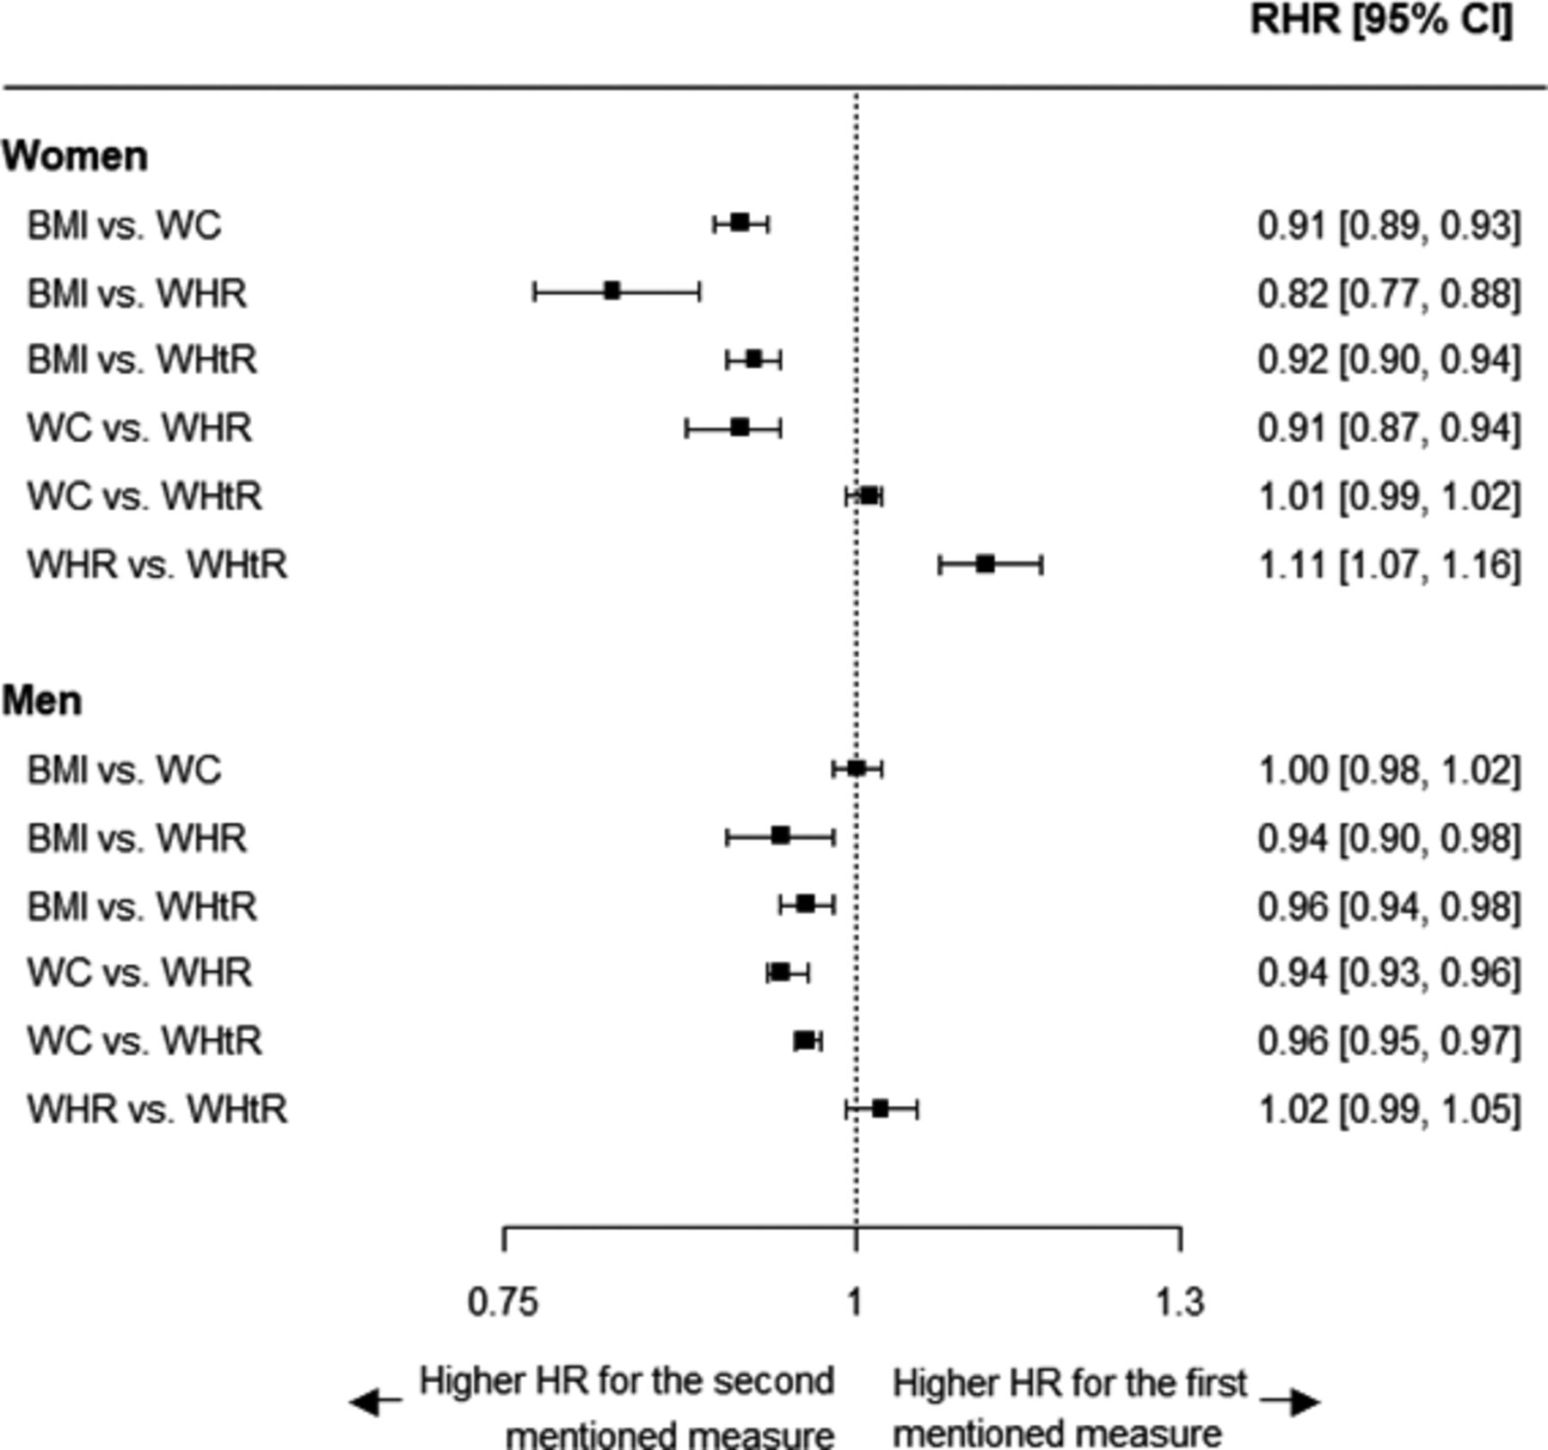
Central Adiposity in women higher risk of MI than men.
Peters, S., Bots, Ss., et al. Sex differences in the association between measures of general and central adiposity and risk of MI. J Am Heart Assoc. March 13, 2018;7:DOI:10.1161/JAHA.117.008507

Slide 12
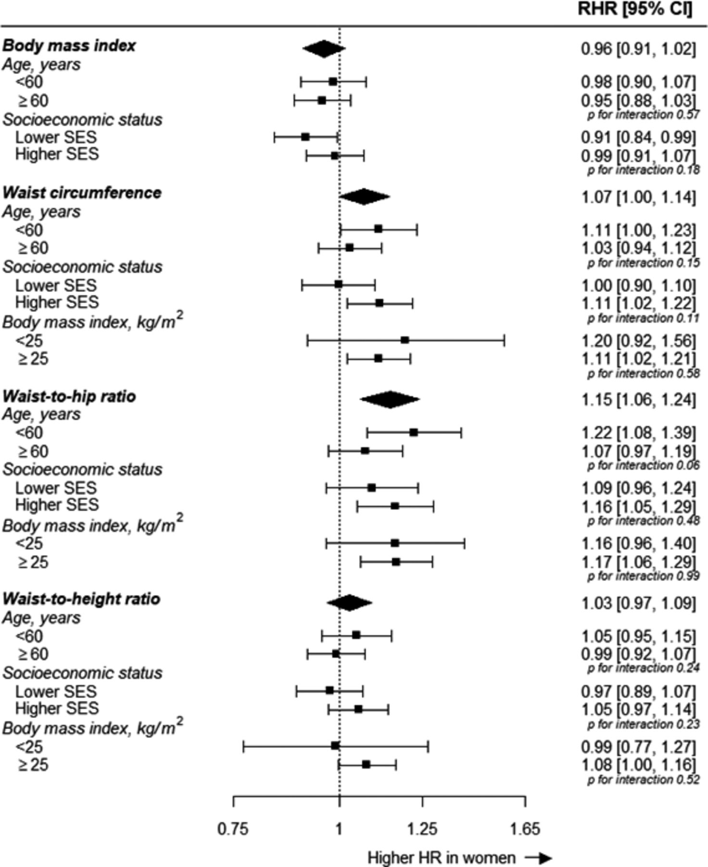
Central Adiposity in women higher risk of MI than men.
Peters, S., Bots, Ss., et al. Sex differences in the association between measures of general and central adiposity and risk of MI. J Am Heart Assoc. March 13, 2018;7:DOI:10.1161/JAHA.117.008507

Slide 13
Central Adiposity in women higher risk of MI than men.
Although general and central adiposity measures each have profound deleterious effects on the risk of MI in both sexes,
Waist circumference and MI:
Women: 1.35 (1.28-1.42), Men: 1.28 (1.23-1.37)
Waist-to-hip ratio and MI:
Women: 1.49 (1.39-1.59), Men: 1.36 (1.30-1.43)
Waist-to-hip ratio was more strongly associated with the risk of MI than body mass index in both sexes, especially in women.
Peters, S., Bots, Ss., et al. Sex differences in the association between measures of general and central adiposity and risk of MI. J Am Heart Assoc. March 13, 2018;7:DOI:10.1161/JAHA.117.008507

Slide 14

Central Adiposity in women higher risk of MI than men.
Measures of central adiposity, but not of general adiposity, were more strongly associated with the risk of MI in women than in men. Measures of central adiposity, particularly waist-to-hip ratio, were more strongly associated with the risk of MI than general adiposity, especially among women.
What Are the Clinical Implications?
Compared with body mass index, measures of central adiposity may be a better indicator of the risk of MI risk with adiposity in women and men (highest in women)
BaleDoneen Take-Away:
MEASURE!
Waist is a vital sign!
Central Adiposity is dangerous – measure waist and hip.
Biometric scales are terrific (this study didn’t look at that aspect).
Peters, S., Bots, Ss., et al. Sex differences in the association between measures of general and central adiposity and risk of MI. J Am Heart Assoc. March 13, 2018;7:DOI:10.1161/JAHA.117.008507

Slide 15

HIV and Peripheral Arterial Disease

Slide 16

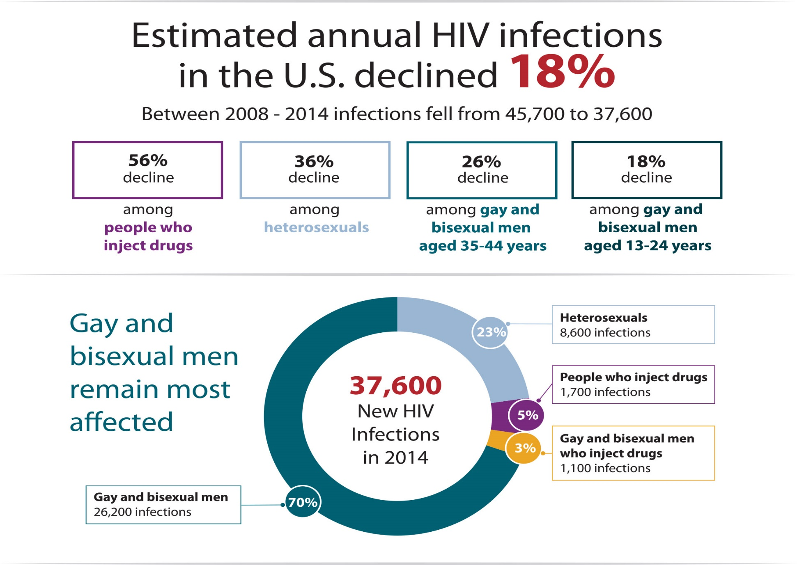

Slide 17
HIV and PAD
Investigated whether HIV infection is associated with an increased risk of PAD after adjustment for traditional atherosclerotic risk factors in a large cohort of HIV infected (HIV+) and demographically similar HIV uninfected veterans.
Veterans Aging Cohort Study from 2003 through 2014. Excluded participants with known prior PAD or prevalent CVD (MI, CVA, CHD, CHF)
Analyzed the effect of HIV status on the risk of incident PAD events after adjusting for demographics, PAD risk factors, substance use, CD4 cell count, HIV-1 RNA, and antiretroviral therapy.
Primary outcome: Incident PAD events.
Secondary outcomes: mortality and amputation in subjects with incident PAD events by HIV infection status, viral load, and CD4 count.
Beckman, J., Duncan, M., et al. HIV and PAD. March 12, 2018. Circulation; 10.1161.117.032647

Slide 18

HIV and PAD
Among 91,953 participants, over a median follow up of 9.0 years, there were 7708 incident PAD events.
Rates of incident PAD events per 1000 person-years were higher among HIV+ 11.9 (95% CI 11.5-12.4) than uninfected veterans 9.9 (95% CI 9.6-10.1).
After adjustments HIV veterans had an increased risk of incident PAD events compared to uninfected veterans HR 1.19 (95% CI 1.13-1.25).
Beckman, J., Duncan, M., et al. HIV and PAD. March 12, 2018. Circulation; 10.1161.117.032647

Slide 19
HIV and PAD
This risk was highest among those with time-updated HIV viral load>500 copies/ml (HR=1.51, 95% CI=1.38-1.65) and CD4 cell counts<200 cells/mm3 (HR=1.91, 95% CI 1.71-2.13).
In contrast, CD4 cell count≥500 cells/mm3 had no increased risk of PAD (HR=1.03, 95% CI=0.96-1.11).
Mortality rates after incident PAD events are high regardless of HIV status. HIV infection did not affect Rates of amputation after incident PAD events.
Beckman, J., Duncan, M., et al. HIV and PAD. March 12, 2018. Circulation; 10.1161.117.032647

Slide 20
HIV and PAD
Infection with HIV is associated with a 19% increased risk of PAD beyond that <200 cells/mm3.
The risk of incident PAD events is nearly two-fold higher for those with sustained CD4 cell counts <200 cells/mm3.
When CD4 cell counts ≥500 cells/mm3 there is no excess risk of incident PAD events compared to uninfected people.
Beckman, J., Duncan, M., et al. HIV and PAD. March 12, 2018. Circulation; 10.1161.117.032647

Slide 21

HIV and PAD
BaleDoneen Take-Away:
Although decreasing, HIV is still a prevalent viral infection. Historically the treatments for HIV has placed individuals in a vulnerable metabolic syndrome risk. EDUCATION!
Recognize HIV as a red flag for CVD. Get work up, including ABIs
There are Preventative treatments now for HIV (2014 – Truvada)
PrEP – pre-exposure prophylaxis. Given to people who are HIV negative but at high risk to contract the disease. Must be taken daily and is not a vaccine. Shows a 92% lower risk for individuals of contracting HIV. Regular HIV screening is necessary and regular precautions.
Beckman, J., Duncan, M., et al. HIV and PAD. March 12, 2018. Circulation; 10.1161.117.032647

Slide 22
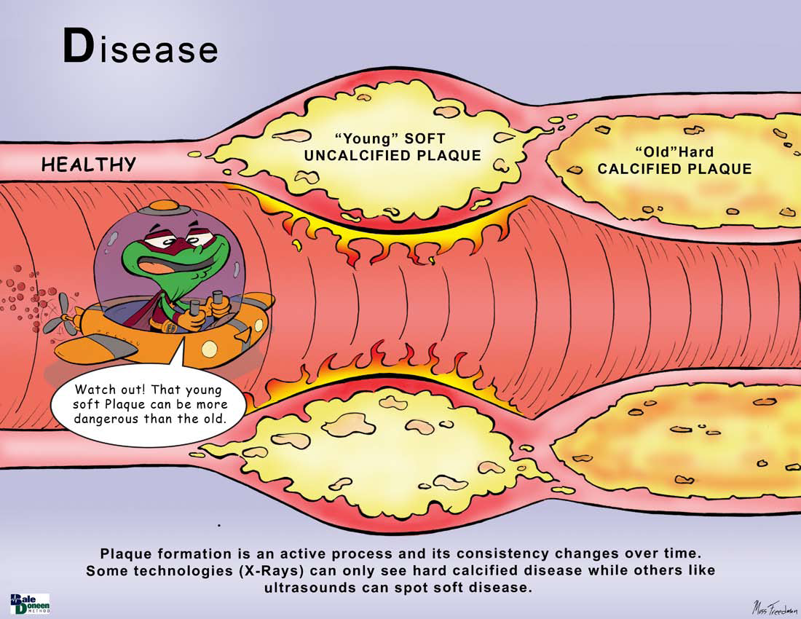

Slide 23

Heart Muscle Scarring in Women
This Photo by Unknown Author is licensed under CC BY-NC-SA

Slide 24
Myocardial Scar and subclinical myocardial dysfunction in women
Women with suspected ischemia and no obstructive CAD (INOCA) have high prevalence of coronary microvascular dysfunction and elevated event rates.
WISE-CVD study – women with suspected INOCA. N=179 included with baseline cardiac magnetic resonance (CMR) and late gadolinium enhancement (LGE) imaging and follow-up in one year.
Wei, J., Bakir, M., Darounian, N., et al. Myocardial scar is prevalent and associated with subclinical myocardial dysfunction in women with suspected ischemia but no obstructive coronary artery disease. Circulation. 2018;137:874-876.

Slide 25
Myocardial Scar and subclinical myocardial dysfunction in women
Among women with suspected ischemia, scarring prevalence was 8% with an annual 1% new scarring incidence.
1/3 of women with LGE did not have prior diagnosis of MI, suggesting that women with suspected ischemia not uncommonly have a clinically underdiagnosed myocardial scar.
Further typing is needed to better understand women and CAD – myocarditis, vasospasm, scarring….etc.
Wei, J., Bakir, M., Darounian, N., et al. Myocardial scar is prevalent and associated with subclinical myocardial dysfunction in women with suspected ischemia but no obstructive coronary artery disease. Circulation. 2018;137:874-876.

Slide 26

Myocardial Scar and subclinical myocardial dysfunction in women
BaleDoneen Take-Away:
Women are vulnerable to microvascular damage but may not present with common symptoms.
Watch NT-ProBNP and hsTnT in women – particularly that are vulnerable to CVD or with know ASVD/IMT.
Further research is needed in this vulnerable group – adding biomarkers to regular assessment helps to tease out who might be most vulnerable to negative outcomes.
Wei, J., Bakir, M., Darounian, N., et al. Myocardial scar is prevalent and associated with subclinical myocardial dysfunction in women with suspected ischemia but no obstructive coronary artery disease. Circulation. 2018;137:874-876.

Slide 27
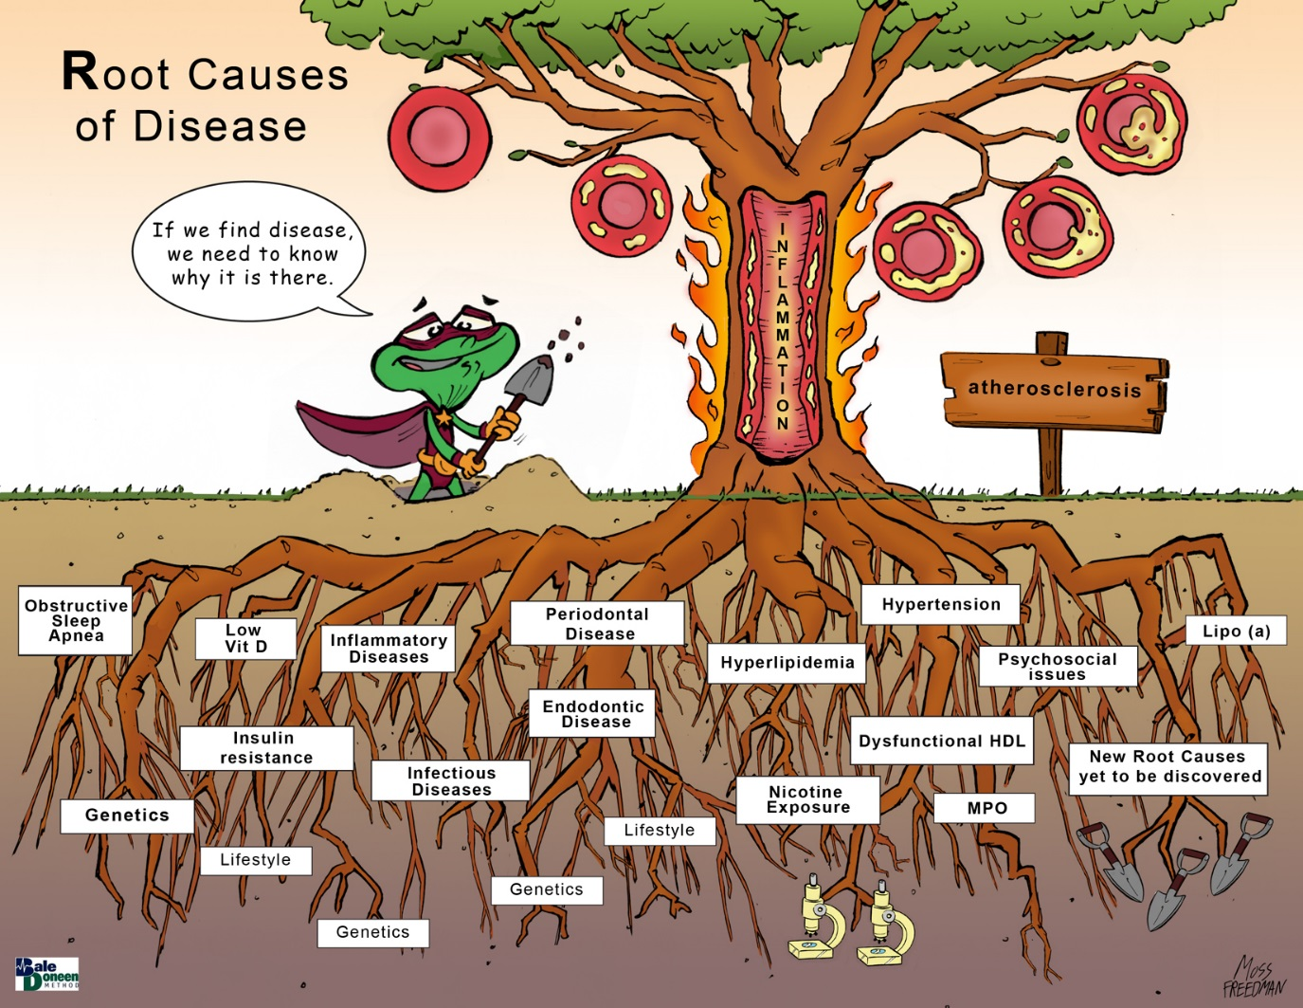
Nicotine
Endodontic Disease
Gut dysbiosis

Slide 28
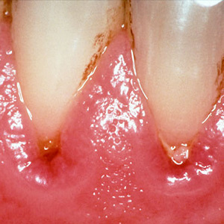
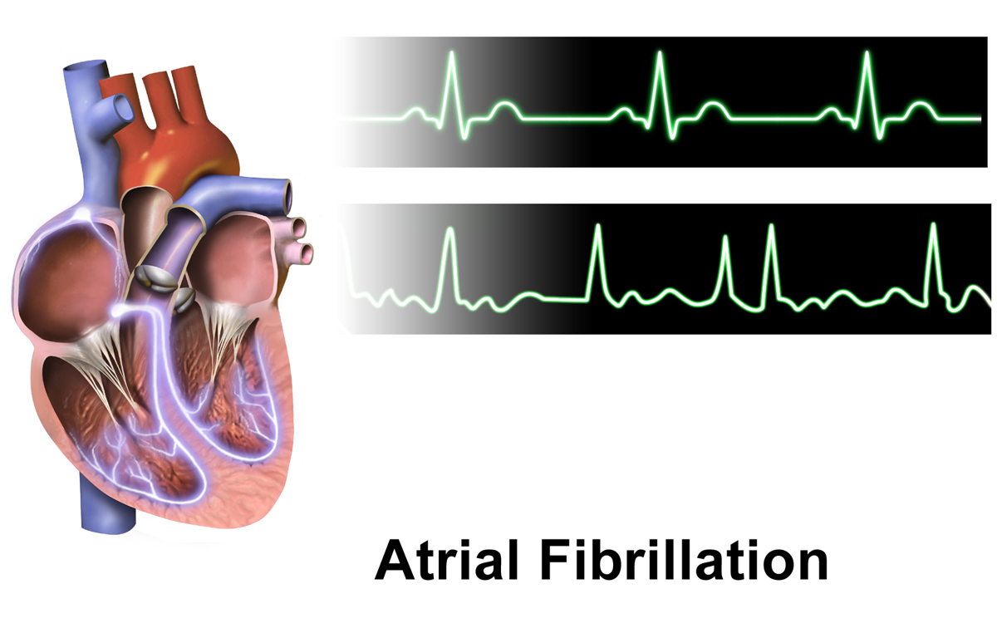
Periodontal Disease and
Atrial Fibrillation

Slide 29
First – A review from last month’s scientific update session
Feb 2018 from Brad F. Bale M.D.

Slide 30
Periodontal Disease Independently Related to Stroke Risk & Dental Care May Lower Risk:
Background
Periodontal disease (PD) is a chronic inflammatory disease.
The prevalence of PD is high with over 50% of Americans >30 yo being affected.
Sen, S., et. al. (2018). Periodontal Disease, Regular Dental Care Use, and Incident Ischemic Stroke. Stroke. doi:10.1161/strokeaha.117.018990

Slide 31
Periodontal Disease Independently Related to Stroke Risk & Dental Care May Lower Risk:
Background
PD is associated with elevated systemic inflammatory markers.
PD may be related to stroke incidence through systemic inflammation.
Sen, S., et. al. (2018). Periodontal Disease, Regular Dental Care Use, and Incident Ischemic Stroke. Stroke. doi:10.1161/strokeaha.117.018990

Slide 32
Bale, B. F., Doneen, A. L., & Vigerust, D. J. (2017). High-risk periodontal pathogens contribute to the pathogenesis of atherosclerosis. Postgraduate Medical Journal, 93(1098), 215-220.

Slide 33
Periodontal Disease Independently Related to Stroke Risk & Dental Care May Lower Risk:
Background
Observational studies have shown PD is associated with an increased stroke risk.
Post hoc analyses of prospective–longitudinal and smaller case–control studies have reported an association between PD and incident stroke.
Sen, S., et. al. (2018). Periodontal Disease, Regular Dental Care Use, and Incident Ischemic Stroke. Stroke. doi:10.1161/strokeaha.117.018990

Slide 34
Periodontal Disease Independently Related to Stroke Risk & Dental Care May Lower Risk:
Background
A combined analysis of 2 prospective studies showed PD tripled the risk of stroke.
A meta-analysis of 2 cohort studies showed PD increased the risk of stroke 1.6X.
Sen, S., et. al. (2018). Periodontal Disease, Regular Dental Care Use, and Incident Ischemic Stroke. Stroke. doi:10.1161/strokeaha.117.018990

Slide 35
Periodontal Disease Independently Related to Stroke Risk & Dental Care May Lower Risk:
Background
Brushing teeth more frequently can decrease systemic inflammatory markers.
One study found that dental prophylaxis or PD treatment reduced the incidence of stroke.
Sen, S., et. al. (2018). Periodontal Disease, Regular Dental Care Use, and Incident Ischemic Stroke. Stroke. doi:10.1161/strokeaha.117.018990

Slide 36
Periodontal Disease Independently Related to Stroke Risk & Dental Care May Lower Risk:
Background
Stroke incidence is high and it remains the leading cause of disability in the US.
PD is potentially a modifiable stroke risk factor.
Sen, S., et. al. (2018). Periodontal Disease, Regular Dental Care Use, and Incident Ischemic Stroke. Stroke. doi:10.1161/strokeaha.117.018990

Slide 37
Periodontal Disease Independently Related to Stroke Risk & Dental Care May Lower Risk:
Background
Limitations with previous studies include the use of many differing definitions of periodontal disease and consideration of potential cofounders.
The current study uses robust periodontal clinical definitions and adjusted for numerous potential cofounders of stroke risk.
Sen, S., et. al. (2018). Periodontal Disease, Regular Dental Care Use, and Incident Ischemic Stroke. Stroke. doi:10.1161/strokeaha.117.018990

Slide 38
Periodontal Disease Independently Related to Stroke Risk
6,736 ARIC pts; no hx of stroke; mean age 62; 55% female; 19% Black; follow-up 15 yrs with over 90% of pts being retained in study.
Periodontal exams used to discriminate pts into 7 distinct periodontal profile classes (PPC A-G) ranging from health to severe PD.
Sen, S., et. al. (2018). Periodontal Disease, Regular Dental Care Use, and Incident Ischemic Stroke. Stroke. doi:10.1161/strokeaha.117.018990
Notes:
a latent class analysis to identify discrete classes of individuals that are discriminated by tooth-level clinical parameters to define 7 distinct periodontal profile classes (PPC A-G) ranging from health to severe periodontal disease status, validated in 3 large cohorts.
Episodic= only when in discomfort, something needed to be fixed, never, or did not receive regular dental care

Slide 39
Seven Periodontal Profile Classes (PPC):
Background
Latent class analysis (LCA) is a statistical method used to identify a set of discrete, mutually exclusive latent classes of individuals based on their responses to a set of observed categorical variables.
It is a data-driven, person-centered approach that considers heterogeneity among individuals that can be grouped into relatively homogeneous subclasses with similar clinical patterns.
Morelli, T., et. al. (2017). Derivation and Validation of the Periodontal and Tooth Profile Classification System for Patient Stratification. J Periodontol, 88(2), 153-165.

Slide 40
Seven Periodontal Profile Classes (PPC)
Dental Atherosclerosis Risk in Community Study (DARIC) cohort (n=6793) was used to develop the LCA classification.
7 tooth-level clinical parameters drove the classification.
Morelli, T., et. al. (2017). Derivation and Validation of the Periodontal and Tooth Profile Classification System for Patient Stratification. J Periodontol, 88(2), 153-165.

Slide 41
Periodontal Disease and
Atrial Fibrillation

Slide 42
Periodontal Disease Associated with Atrial Fibrillation
Previously reported that PD is associated with cardioembolic stroke
AF is the most common reason for cardioembolic stroke
Authors assessed the hypothesis that PD is associated with incident AF.
Sen, S., et. al. (March 12, 2018). Periodontal Disease, Regular Dental Care Use, and Incident Ischemic Stroke. Stroke; 49:ATMP55.

Slide 43
Periodontal Disease Associated with Atrial Fibrillation
In the Dental Atherosclerosis in Communities Study (DARIC) study, participants were subjected to full-mouth clinical periodontal measurements (seven indices) –
PPC (A=periodontal health and F through G, based on increasing severity of PD)described previously (Feb 2018 BD Scientific Update).
Cox regression used to adjust for AF risk factors that can potentially confound the relationship between PPC and AF adjudicated using echocardiograms, hospital codes and death certificates over the 17 years
Sen, S., et. al. (March 12, 2018). Periodontal Disease, Regular Dental Care Use, and Incident Ischemic Stroke. Stroke; 49:ATMP55.

Slide 44
Periodontal Disease Associated with Atrial Fibrillation
Of the 6,501 assessed on visit 4 without prior history of AF, 883 were found to have AF over a 17-year follow-up period.
Periodontal disease (PPC classes B-G) compared with periodontal health (PPC-A) was associated with higher rate of AF (HR 1.3 95% CI 1.1-1.5. p=0.0008).
PPC-D (HR 1.4 95% CI 1.1-1.7)
PPC-E (HR 1.4 95% CI 1.2-1.8)
PPC-F (HR 1.6 95% CI 1.3-2.0)
PPC-G (HR 1.4 95% CI 1.04-1.8)
On multivariate analysis only, PPC-F or severe tooth loss (adjusted HR 1.3 95% CI 1.01-1.6) was significantly associated with AF.
Sen, S., et. al. (March 12, 2018). Periodontal Disease, Regular Dental Care Use, and Incident Ischemic Stroke. Stroke; 49:ATMP55.

Slide 45
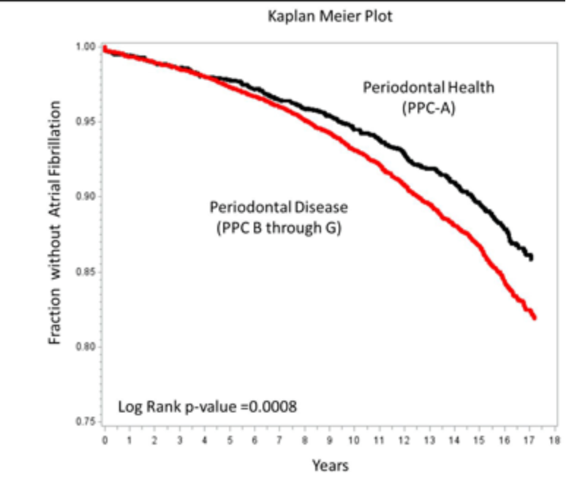
Periodontal Disease Associated with Atrial Fibrillation
Sen, S., et. al. (March 12, 2018). Periodontal Disease, Regular Dental Care Use, and Incident Ischemic Stroke. Stroke; 49:ATMP55.

Slide 46
Periodontal Disease Associated with Atrial Fibrillation
BaleDoneen Take-Away:
1. Significant association with periodontal disease and AF.
2. Among the PPC, PPC-F or severe tooth loss is independently associated with AF.
3. The association may help explain the cardioembolic stroke risk noted with PD.
4. This is another opportunity for the medical and dental communities to begin talking and working together for the optimal health of the patient.
Sen, S., et. al. (March 12, 2018). Periodontal Disease, Regular Dental Care Use, and Incident Ischemic Stroke. Stroke; 49:ATMP55.

Slide 47

We have been following this story for some time…

Slide 48
Oral health and AF?
Community-based population in Stockholm, Sweden, cross sectional, longitudinal. n=125 dentate individuals > age 80 years. Active root caries, active coronal caries and periodontitis were assessed.
Primary finding of the multivariate logistic regression was that persons with three or more active root caries had more than twice the odds of cardiac arrhythmias than those without.
OR 2.8 (95% CI, 1.1-7.0)
Association between periodontal disease and arrhythmia found in older individuals.
Holm-Pedersen, Avlund, K., Morse, D., et al. (2005).Dental Caries, Periodontal Disease, and Cardiac Arrhythmias in Community-Dwelling Older Persons aged 80 and Older: Is There a Link? J Am Geriatr Soc 53:430-437.

Slide 49
Oral health and AF?
Holm-Pedersen, Avlund, K., Morse, D., et al. (2005).Dental Caries, Periodontal Disease, and Cardiac Arrhythmias in Community-Dwelling Older Persons
aged 80 and Older: Is There a Link? J Am Geriatr Soc 53:430-437.

Slide 50

What can be done to prevent AF, especially in our most vulnerable groups –
Periodontal patients? Elderly?
Let’s review…….

Slide 51
Atrial Fibrillation
AF incidence currently 2.7-6.7 million (U.S) - Projected to reach 5.6 to 15.9 million by 2050
Despite increased awareness, 1/3 of AF population is asymptomatic - Has been suggested that mass screening is reasonable
AF associated with 40-90% increased risk for morbidity with:
5-fold increase for stroke
3-fold increase risk for heart failure
2-fold increased risk for dementia
Du, X., Dong, J., Ma, Ch. (2017). Is Atrial Fibrillation a Preventable Disease? Journal of the American College of Cardiology, 69 (15), 1968-82.

Slide 52
Atrial Fibrillation
To reduce AF burden, it is essential to embrace prevention
AF treatment has been focused on stroke prevention rather than actually preventing the AF itself.
Modifiable Risk Factors for the prevention of AF.
Alcohol use
Physical Activity
Psychosocial Factors
Smoking
Obesity or Overweight
Du, X., Dong, J., Ma, Ch. (2017). Is Atrial Fibrillation a Preventable Disease? Journal of the American College of Cardiology, 69 (15), 1968-82.

Slide 53
Alcohol and AF risk
Risk for AF increased with increased ETOH consumption (meta):
More than 21 drinks/week increased AF by 39%
>35 drinks/week increased AF by 45%
Specifically in women:
>2 drinks/day increased AF by 60% (WHS)
Studies specifically in men:
1.5 drinks/day increased AF by 25 - 46% (Danish)
Recent prospective study (men & women):
Each additional drink per day was associated with an estimated 8% increase in RR for AF
Du, X., Dong, J., Ma, Ch. (2017). Is Atrial Fibrillation a Preventable Disease? Journal of the American College of Cardiology, 69 (15), 1968-82.

Slide 54
Physical Activity and AF risk
Association between physical activity (PA) & cardiometabolic fitness and AF varies greatly between intensity and frequency
Du, X., Dong, J., Ma, Ch. (2017). Is Atrial Fibrillation a Preventable Disease? Journal of the American College of Cardiology, 69 (15), 1968-82.

Slide 55
Physical Activity and AF risk
Du, X., Dong, J., Ma, Ch. (2017). Is Atrial Fibrillation a Preventable Disease? Journal of the American College of Cardiology, 69 (15), 1968-82.

Slide 56
Psychosocial Factors and AF
FRS assessed increased risk of AF in men (not women):
trait anger – increased AF risk by 10%
hostility – increased AF risk by 30%
symptoms of anger – increased AF risk by 20%
tension – increased AF by 24%
Other studies demonstrated:
Panic disorder associated with 73% increased AF risk over a 7 year time frame.
Swedish longitudinal study:
high job strain associated with increased of AF by 23%
Survey of 100 patients with idiopathic paroxysmal AF stated that psychological stress triggered 54% of AF episodes.
Women who felt happy (WHS) had a 30% reduced AF risk.
Du, X., Dong, J., Ma, Ch. (2017). Is Atrial Fibrillation a Preventable Disease? Journal of the American College of Cardiology, 69 (15), 1968-82.

Slide 57
Physical Activity and AF risk
Du, X., Dong, J., Ma, Ch. (2017). Is Atrial Fibrillation a Preventable Disease? Journal of the American College of Cardiology, 69 (15), 1968-82.

Slide 58
Smoking and AF risk
Rotterdam study reported a 51% increased risk of AF development among current and former smokers.
This included 2nd hand exposure during gestational development and childhood was associated with a higher risk of AF later in life.
Risk of AF does reduce after quitting.
ARIC showed a 2-fold increased risk for development of AF.
Du, X., Dong, J., Ma, Ch. (2017). Is Atrial Fibrillation a Preventable Disease? Journal of the American College of Cardiology, 69 (15), 1968-82.

Slide 59
Smoking and AF risk
Du, X., Dong, J., Ma, Ch. (2017). Is Atrial Fibrillation a Preventable Disease? Journal of the American College of Cardiology, 69 (15), 1968-82.

Slide 60
Obesity and Overweight and AF risk
Obesity increased risk for AF by 49% (men and women)
In all studies – BMI had a linear association with AF risk – with each unit increase increasing AF risk by 4-8%.
Birth weight shows association (<5.5 lb vs > 10 lbs) shows 27% increased risk of AF (linear association).
Weight loss: > 10% weight loss - 45.5% reduced AF risk
3-9% weight loss - 22.2% reduced AF risk
<3% weight loss - 13.4% reduced AF risk
Du, X., Dong, J., Ma, Ch. (2017). Is Atrial Fibrillation a Preventable Disease? Journal of the American College of Cardiology, 69 (15), 1968-82.

Slide 61
Weight and AF risk
Du, X., Dong, J., Ma, Ch. (2017). Is Atrial Fibrillation a Preventable Disease? Journal of the American College of Cardiology, 69 (15), 1968-82.

Slide 62
BP and Pulse Pressure & AF risk
For every 10mmHg increase in SBP, the risk for AF increases by 11% - BP is stated to be the MOST IMPORTANT contributor to the burden of AF.
Poor BP control was associated with a 7-fold higher risk for developing new-onset AF during 2 years of follow-up.
Pulse Pressure (aortic stiffness), is a strong predictor of AF – each 20mmHg increase in pulse pressure was associated with a 26% increase in the risk for developing AF.
Du, X., Dong, J., Ma, Ch. (2017). Is Atrial Fibrillation a Preventable Disease? Journal of the American College of Cardiology, 69 (15), 1968-82.

Slide 63
BP and Pulse Pressure & AF risk
Du, X., Dong, J., Ma, Ch. (2017). Is Atrial Fibrillation a Preventable Disease? Journal of the American College of Cardiology, 69 (15), 1968-82.

Slide 64
BP Treatment & reduced AF risk
Meta-analyses of trials comparing effects of ACE-Inhibitors or ARBs and placebo on AF in patients with heart failure showed that almost 50% of cases of AF could be prevented if ACE inhibitors or ARBs were consistently used in patients with heart failure.
Du, X., Dong, J., Ma, Ch. (2017). Is Atrial Fibrillation a Preventable Disease? Journal of the American College of Cardiology, 69 (15), 1968-82.

Slide 65
BP and Pulse Pressure & AF risk
Du, X., Dong, J., Ma, Ch. (2017). Is Atrial Fibrillation a Preventable Disease? Journal of the American College of Cardiology, 69 (15), 1968-82.

Slide 66
Diabetes and AF risk
Diabetes is fastest growing public health problem – by 2030, it is predicted that DM will increased world-wide from 366 million to 552 million.
Meta-analysis demonstrates that DM is associated with a 34% increased risk for AF.
33% increase in AF risk for each 1mmol/l increase in FBS
Association is not clear because reduction of FBS not solidly correlated to AF risk reduction.
Du, X., Dong, J., Ma, Ch. (2017). Is Atrial Fibrillation a Preventable Disease? Journal of the American College of Cardiology, 69 (15), 1968-82.

Slide 67
Diabetes and AF risk
Du, X., Dong, J., Ma, Ch. (2017). Is Atrial Fibrillation a Preventable Disease? Journal of the American College of Cardiology, 69 (15), 1968-82.

Slide 68
Obstructive Sleep Apnea and AF risk
Odds ratio for the association between AF and OSA was 2.19 (95% CI: 1.40 to 3.42). (Circulation 2004;110:364-7)
A cause/effect relationship between OSA and AF was established from the Olmsted study – followed mean of 4.7 years – Nocturnal O2 desaturation was found to be an independent risk factor in subjects < 65 years old
(HR: 3.29; 95% CI: 1.35 to 8.04) (JAAC 2007;49:565-71)
Case cross-over design – respiratory disturbance was observed to trigger AF episodes – OR of AF occurring within the 90-second hazard period was 17.9-fold greater than that compared to normal breathing. (JACC 2009;54:1797-804)
Du, X., Dong, J., Ma, Ch. (2017). Is Atrial Fibrillation a Preventable Disease? Journal of the American College of Cardiology, 69 (15), 1968-82.

Slide 69
Obstructive Sleep Apnea and AF risk
Treatment with CPAP – more data needed to demonstrate independent relationship however:
12 months following cardioversion, AF recurrence rate were 82% in untreated OSA patients
42% in CPAP treated patients
53% in those without OSA
(Circulation 2003;107:2589-94)
Significantly lower success rate of ablation therapy among AF patients with OSA (36.7% vs 66.7%) – dramatically increased to 71.9% in those treated with CPAP (JACC 2013;62:300-5)
Du, X., Dong, J., Ma, Ch. (2017). Is Atrial Fibrillation a Preventable Disease? Journal of the American College of Cardiology, 69 (15), 1968-82.

Slide 70
Cardiovascular Disease and AF risk
The incidence of AF is underestimated in patients after MI because silent AF occurs more frequently than symptomatic AF (16% vs 5%).
Heart Failure and AF are also closely related – elevated filling pressure, atrial stretch, atrial remodeling and an active neurohormonal system predispose heart failure patients to AF
About 1/3 of HF patients develop AF while 1/3 of AF patients will develop HF.
Heart Failure is associated with a 4.5 fold increased risk for AF in men and a 5.9 old increased risk in women (including those w/preserved EF)
Du, X., Dong, J., Ma, Ch. (2017). Is Atrial Fibrillation a Preventable Disease? Journal of the American College of Cardiology, 69 (15), 1968-82.

Slide 71
Prevention for the development of AF
Du, X., Dong, J., Ma, Ch. (2017). Is Atrial Fibrillation a Preventable Disease? Journal of the American College of Cardiology, 69 (15), 1968-82.

Slide 72
Prevention for the development of AF
BaleDoneen Take-Away:
1. Go to www.baledoneen.com and take the Genetic AF course
Outline for BDM course on genetics and AF:
Incidence
Screening/Monitoring for AF
Dangers of AF – beyond Stroke
Red Flags for AF
Genetics related to AF – 4Q25
Biomarkers for clinical utility with AF
Treatment for the prevention of AF
Du, X., Dong, J., Ma, Ch. (2017). Is Atrial Fibrillation a Preventable Disease? Journal of the American College of Cardiology, 69 (15), 1968-82.

Slide 73
Atrial Fibrillation
Outline for BDM course on genetics and AF:
Incidence
Screening/Monitoring for AF
Dangers of AF – beyond Stroke
Red Flags for AF
Genetics related to AF – 4Q25
Biomarkers for clinical utility with AF
Treatment for the prevention of AF

Slide 74

Blood Pressure!

Slide 75

“The systolic pressure goal of less than 130 in the forthcoming AHA/ACC guideline….confirmed by multiple experts within the hypertension community – suggests that the writing committee found a middle ground or compromise between the previous goal and the far more aggressive goal suggested by the SPRINT trial.”
Erin Michos (Johns Hopkins) – October 6, 2017

Slide 76
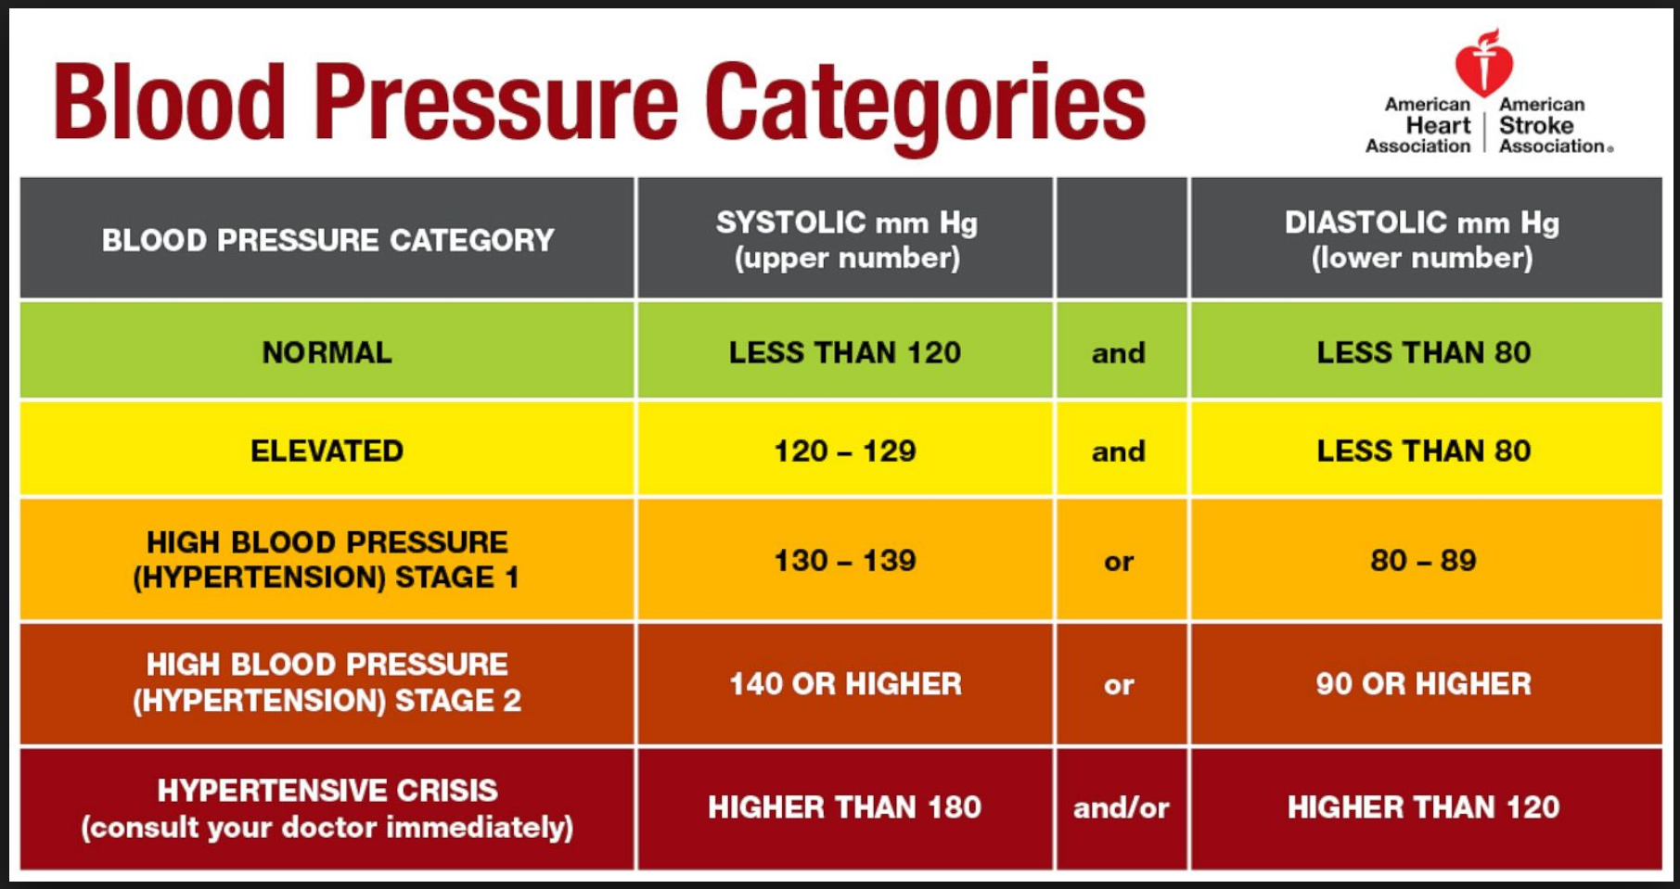
November 2017

Slide 77
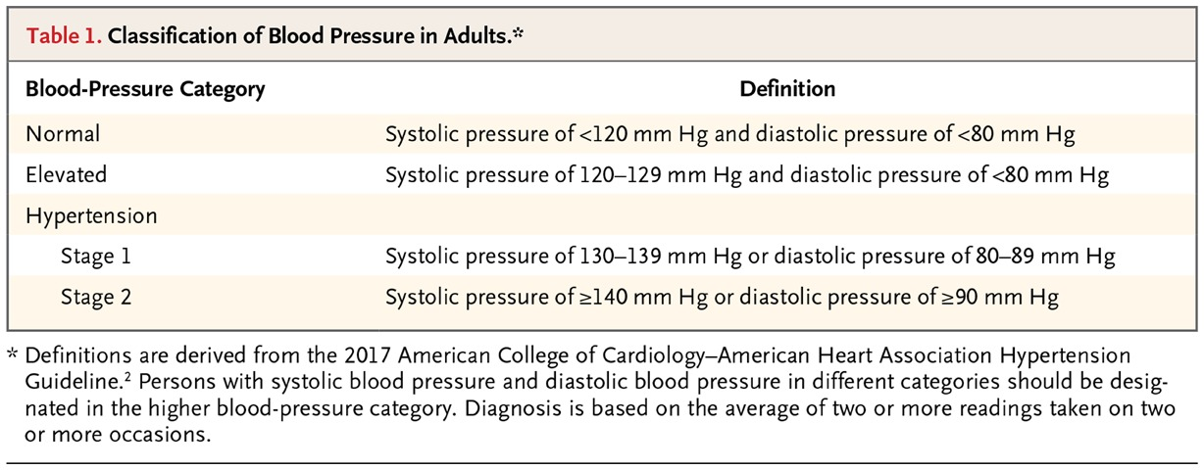

Initial Treatment of Hypertension
Taler SJ. N Engl J Med 2018;378:636-644

Slide 78
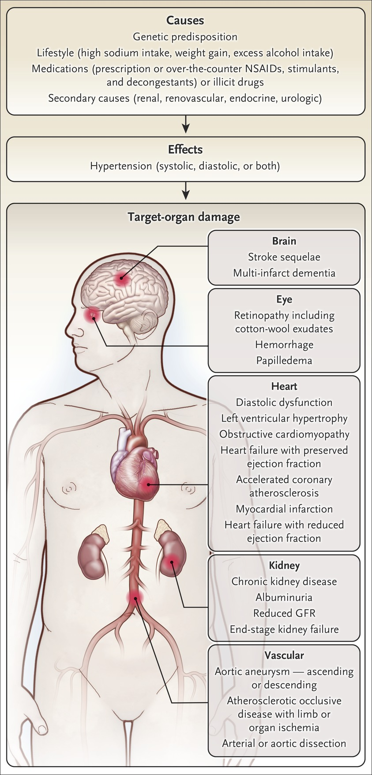
Initial Treatment of Hypertension
Why identify and treat hypertension early?
Stroke
Dementia
Retinopathy
Retinal hemorrhage
Papilledema
Diastolic dysfunction
Left ventricular hypertrophy
Obstructive cardiomyopathy
Heart Failure with preserved EF
Accelerated coronary atherosclerosis
Heart Failure with reduced EF
Chronic Kidney Disease
Albuminuria
Reduced GFR
End-stage Kidney Disease
Aortic aneurysm – ascending or descending
Limb or organ ischemia
Arterial or aortic dissection
Taler SJ. N Engl J Med 2018;378:636-644

Slide 79
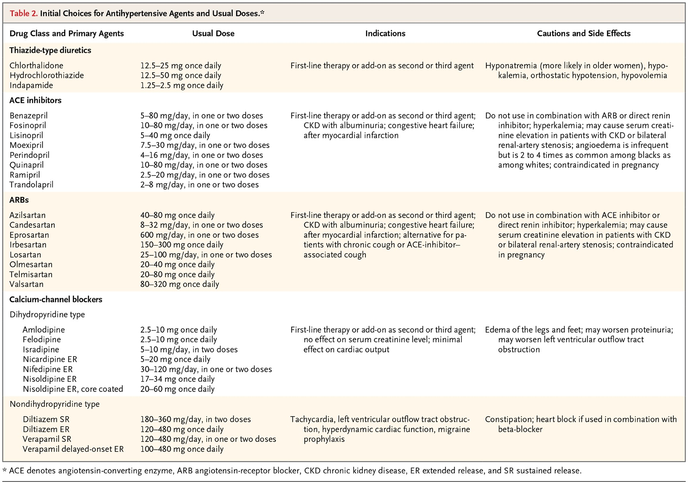
Initial Treatment of Hypertension
Taler SJ. N Engl J Med 2018;378:636-644

Slide 80
Initial Treatment of Hypertension
BaleDoneen Take-Away:
Medical AND Dental offices – post the new guidelines and encourage patients to get home monitoring devices and record first morning BP – bring in to appointments.
Discuss importance of BP knowledge with the FAMILY.
Treatment recommendations validate our current decision tree.
Remember RAAS blockers have larger benefit than just impacting BP – endothelial protection. ACE-I > ARB
Diseases of ageing – want to protect the brain to the toes – optimize Blood Pressure.
Remember Optimal – individualized! Too low is not always ok either.
Taler SJ. N Engl J Med 2018;378:636-644

Slide 81
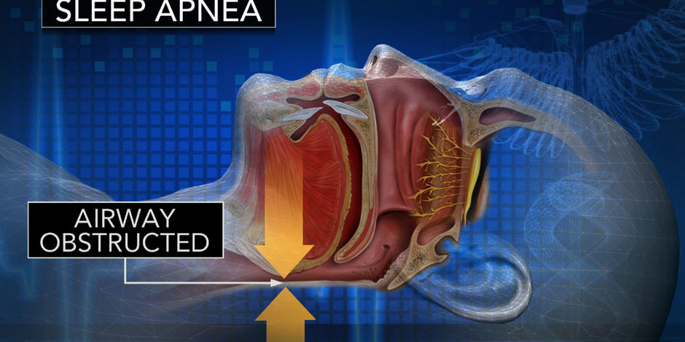
REM and OSA – a risky combination

Slide 82
OSA during REM increased risk in CVD
What does this study add to the current volume of research? Seeks to determine whether OSA primarily during REM sleep increases the risk of cardiovascular disease.
Severe OSA that is present only during REM sleep is associated with recurrent cardiovascular events in people who have prevalent cardiovascular disease
Aurora, R., Crainiceanu, C. et al. (2018) Obstructive sleep apnea during REM sleep and CVD. Am. J. of Resp and Critical Care Medicine. Vol 197, no 5, March1, 2018
Notes:
Hypopneas were scored if there was at least 30% reduction in airflow or thoracoabdominal movement below baseline values for at least 10 seconds. The apnea–hypopnea index (AHI) was defined as the number of apneas and hypopneas, each associated with at least a 4% decrease in oxygen saturation per hour of sleep. An arousal index was derived as the total number of arousals per hour of sleep according to standard criteria Only those participants with at least 30 minutes of REM sleep were included in the analysis to allow for a representative estimate of the REM AHI.

Slide 83
OSA during REM increased risk in CVD
Home polysomnography was conducted as part of the Sleep Heart Health Study. Followed for an average of 9.5 years.
Only participants with a non-REM apnea–hypopnea index (AHI) of less than 5 events/h were included (n=3,265)
Aim was to evaluate REM OSA only
Reference group with REM AHI <5 events/hr was n=1.758)
A composite cardiovascular endpoint was determined as the occurrence of nonfatal or fatal events, including MI, coronary artery revascularization, CHF, and stroke.
Aurora, R., Crainiceanu, C. et al. (2018) Obstructive sleep apnea during REM sleep and CVD. Am. J. of Resp and Critical Care Medicine. Vol 197, no 5, March1, 2018

Slide 84
OSA during REM increased risk in CVD
The adjusted hazards ratios for the composite cardiovascular endpoint in those with severe REM OSA (>30 events/h; n = 180) was 1.35 (95% CI, 0.98–1.85).
Stratified analyses demonstrated that the association was most notable in those with prevalent CVD and severe OSA during REM sleep with an adjusted hazards ratio of 2.56 (95% CI, 1.46–4.47).
Aurora, R., Crainiceanu, C. et al. (2018) Obstructive sleep apnea during REM sleep and CVD. Am. J. of Resp and Critical Care Medicine. Vol 197, no 5, March1, 2018

Slide 85
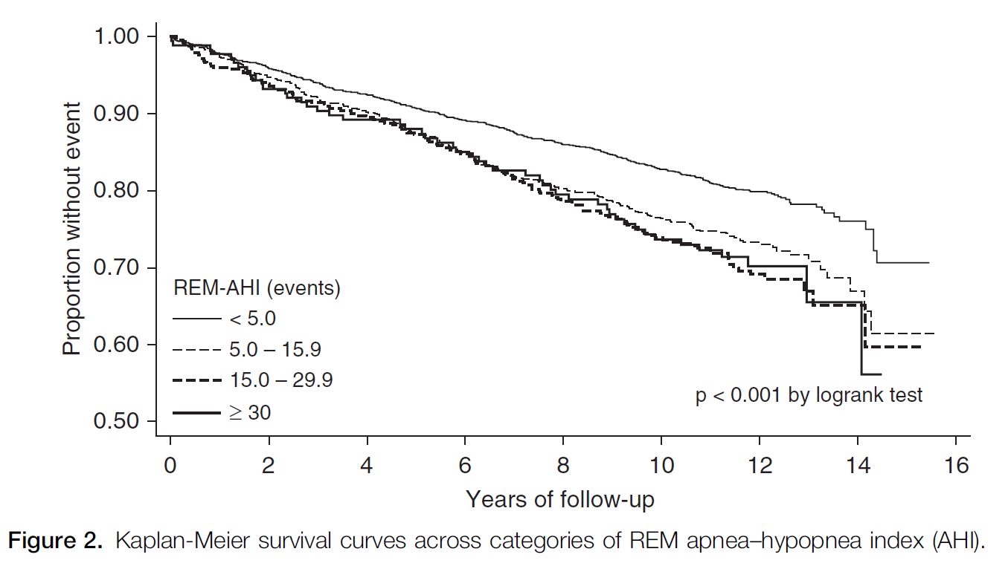
OSA during REM increased risk in CVD
Aurora, R., Crainiceanu, C. et al. (2018) Obstructive sleep apnea during REM sleep and CVD. Am. J. of Resp and Critical Care Medicine. Vol 197, no 5, March1, 2018

Slide 86
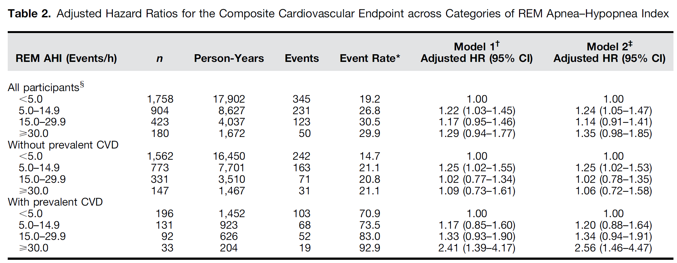
OSA during REM increased risk in CVD
Model 1: adjusted for age (continuous), sex, race, body mass index (continuous), and smoking status (never, former, current). ‡Model 2: adjusted for covariates of model 1 and prevalent hypertension and diabetes.
Participants with known (prevalent) CVD at all levels of AHI >5 showed statistically relevant primary end points.
Aurora, R., Crainiceanu, C. et al. (2018) Obstructive sleep apnea during REM sleep and CVD. Am. J. of Resp and Critical Care Medicine. Vol 197, no 5, March1, 2018

Slide 87
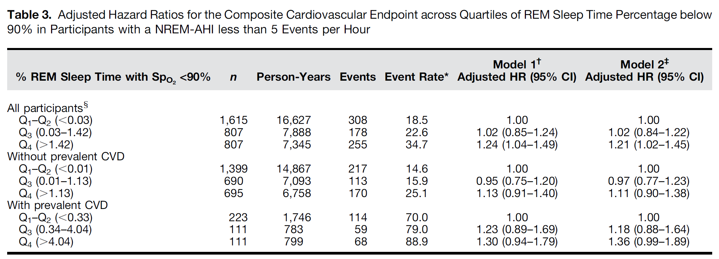
OSA during REM increased risk in CVD
Model 1: adjusted for age (continuous), sex, race, body mass index (continuous), and smoking status (never, former, current). ‡Model 2: adjusted for covariates of model 1 and prevalent hypertension and diabetes.
Participants with known (prevalent) CVD at all levels of REM sleep time percentage below 90% showed statistically relevant primary end points.
Aurora, R., Crainiceanu, C. et al. (2018) Obstructive sleep apnea during REM sleep and CVD. Am. J. of Resp and Critical Care Medicine. Vol 197, no 5, March1, 2018

Slide 88
OSA during REM increased risk in CVD
Conclusion: Severe OSA that occurs primarily during REM sleep is associated with higher incidence of a composite cardiovascular endpoint, but in only those with prevalent cardiovascular disease
BaleDoneen Take-Away:
Home sleep studies are great!
Pay attention to REM OSA – particularly in CVD patients.
Another reason to get the sleep study – more value
Study did not look at treatment resolution of risk.
Dental offices are great resources for home sleep evals.
Aurora, R., Crainiceanu, C. et al. (2018) Obstructive sleep apnea during REM sleep and CVD. Am. J. of Resp and Critical Care Medicine. Vol 197, no 5, March1, 2018

Slide 89


Slide 90

Pharmacogenomics Improves Outcomes!

Slide 91
Guiding antiplatelet therapy in ACS using pharmacogenomics improves outcomes
Clopidogrel is still frequently used in patients with acute coronary syndromes (ACS), but its efficacy is hampered by interpatient response variability
Goal of research: To evaluate whether selecting antiplatelet therapy (clopidogrel, prasugrel or ticagrelor) on the basis of a patient’s genetic and clinical characteristics leads to better clinical outcomes in comparison with the standard of care, which bases the selection on clinical characteristics alone.
Notarangelo, F., Maglietta, G., Bevilacqua, et al. (2018) Pharmacogenomic approach to selecting antiplatelet therapy in acute coronary syndromes: PHARMCLO trial. JACC (2.29.18), doi:10.1016/j.jacc2018.02.029.

Slide 92
Guiding antiplatelet therapy in ACS using pharmacogenomics improves outcomes
Patients hospitalized for ACS were randomly assigned to standard of care or pharmacogenomic arm, which included the genotyping of ABCB1, CYP2C19*2, CYP2C19*17 using an ST Q3 system that provide the data within 70 minutes at each patient’s bedside.
The patients were followed up for 12 ± 1 months for the primary composite endpoint of cardiovascular death and the first occurrence of non-fatal myocardial infarction, non-fatal stroke and BARC 3 to 5-defined major bleeding.
Notarangelo, F., Maglietta, G., Bevilacqua, et al. (2018) Pharmacogenomic approach to selecting antiplatelet therapy in acute coronary syndromes: PHARMCLO trial. JACC (2.29.18), doi:10.1016/j.jacc2018.02.029.

Slide 93
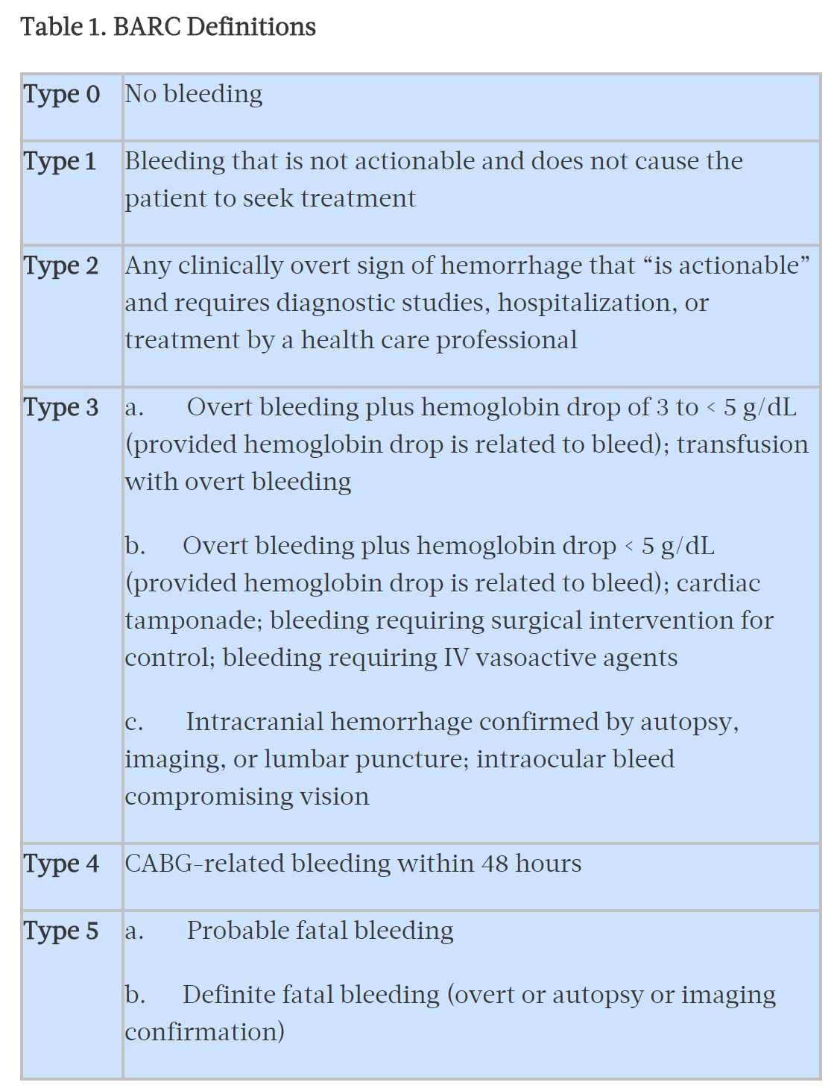
BARC Definitions – bleeding risk
https://www.tctmd.com/news/barc-new-bleeding-definitions-aim-standardize-trial-endpoints

Slide 94
Guiding antiplatelet therapy in ACS using pharmacogenomics improves outcomes
After enrolling 888 patients, the study was prematurely stopped due to significance of outcomes.
Clopidogrel was used more frequently in the standard of care arm (50.7% vs 43.3%), ticagrelor in the pharmacogenomic arm (42.6% vs 32.7%; P=0.02), and prasugrel was equally used in both arms.
Notarangelo, F., Maglietta, G., Bevilacqua, et al. (2018) Pharmacogenomic approach to selecting antiplatelet therapy in acute coronary syndromes: PHARMCLO trial. JACC (2.29.18), doi:10.1016/j.jacc2018.02.029.

Slide 95
Guiding antiplatelet therapy in ACS using pharmacogenomics improves outcomes
.
The primary endpoint occurred in 71 patients (15.9%) in the pharmacogenomic arm and in 114 (25.9%) in the standard of care arm (HR 0.58; 95% CI 0.43 to 0.78; P<0.001).
Conclusion: A personalized approach to selecting antiplatelet therapy for ACS patients may reduce ischemic and bleeding events.
Pharmacogenomics reduced event risk and adverse bleeding risks by 42%!!!
Notarangelo, F., Maglietta, G., Bevilacqua, et al. (2018) Pharmacogenomic approach to selecting antiplatelet therapy in acute coronary syndromes: PHARMCLO trial. JACC (2.29.18), doi:10.1016/j.jacc2018.02.029.

Slide 96
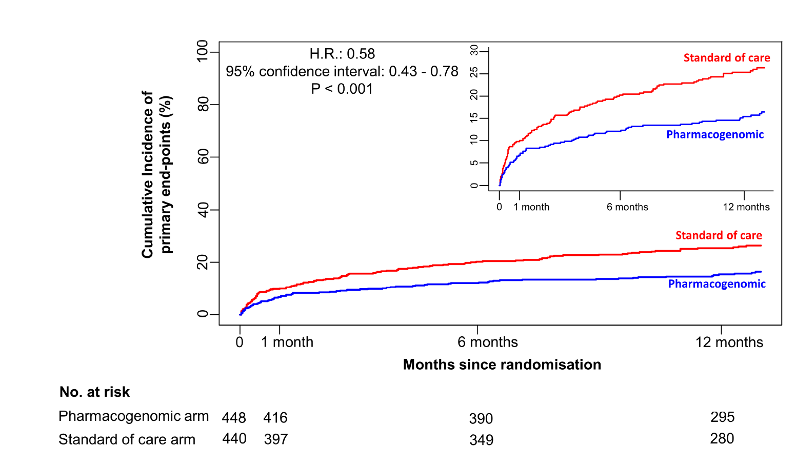
Guiding antiplatelet therapy in ACS using pharmacogenomics improves Primary EndPoints
Notarangelo, F., Maglietta, G., Bevilacqua, et al. (2018) Pharmacogenomic approach to selecting antiplatelet therapy in acute coronary syndromes: PHARMCLO trial. JACC (2.29.18), doi:10.1016/j.jacc2018.02.029.

Slide 97
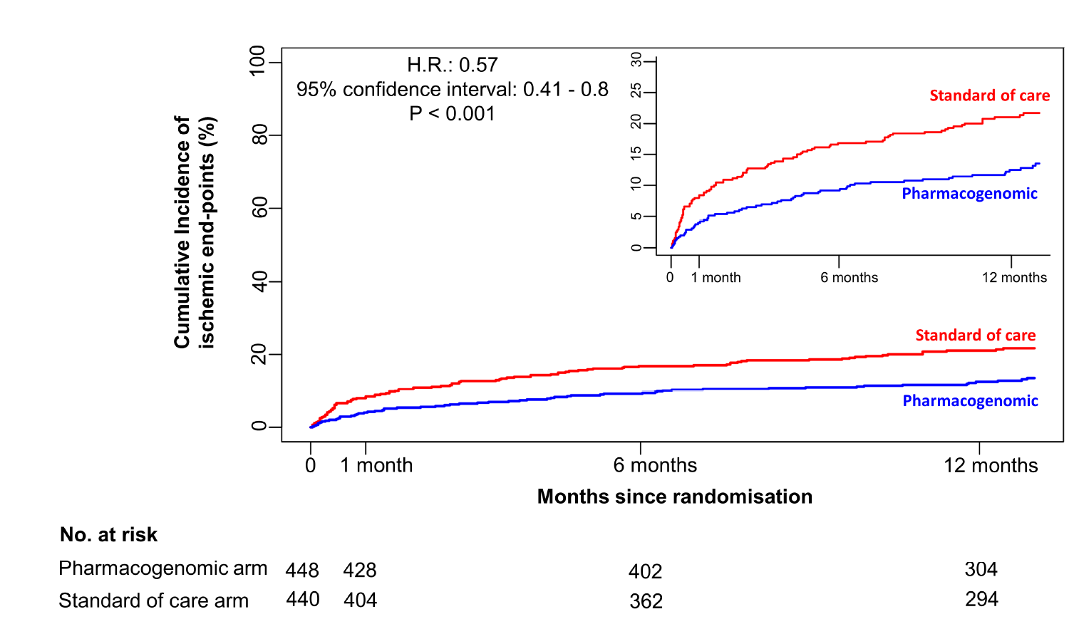
Guiding antiplatelet therapy in ACS using pharmacogenomics improves Ischemic End-Points
Notarangelo, F., Maglietta, G., Bevilacqua, et al. (2018) Pharmacogenomic approach to selecting antiplatelet therapy in acute coronary syndromes: PHARMCLO trial. JACC (2.29.18), doi:10.1016/j.jacc2018.02.029.

Slide 98
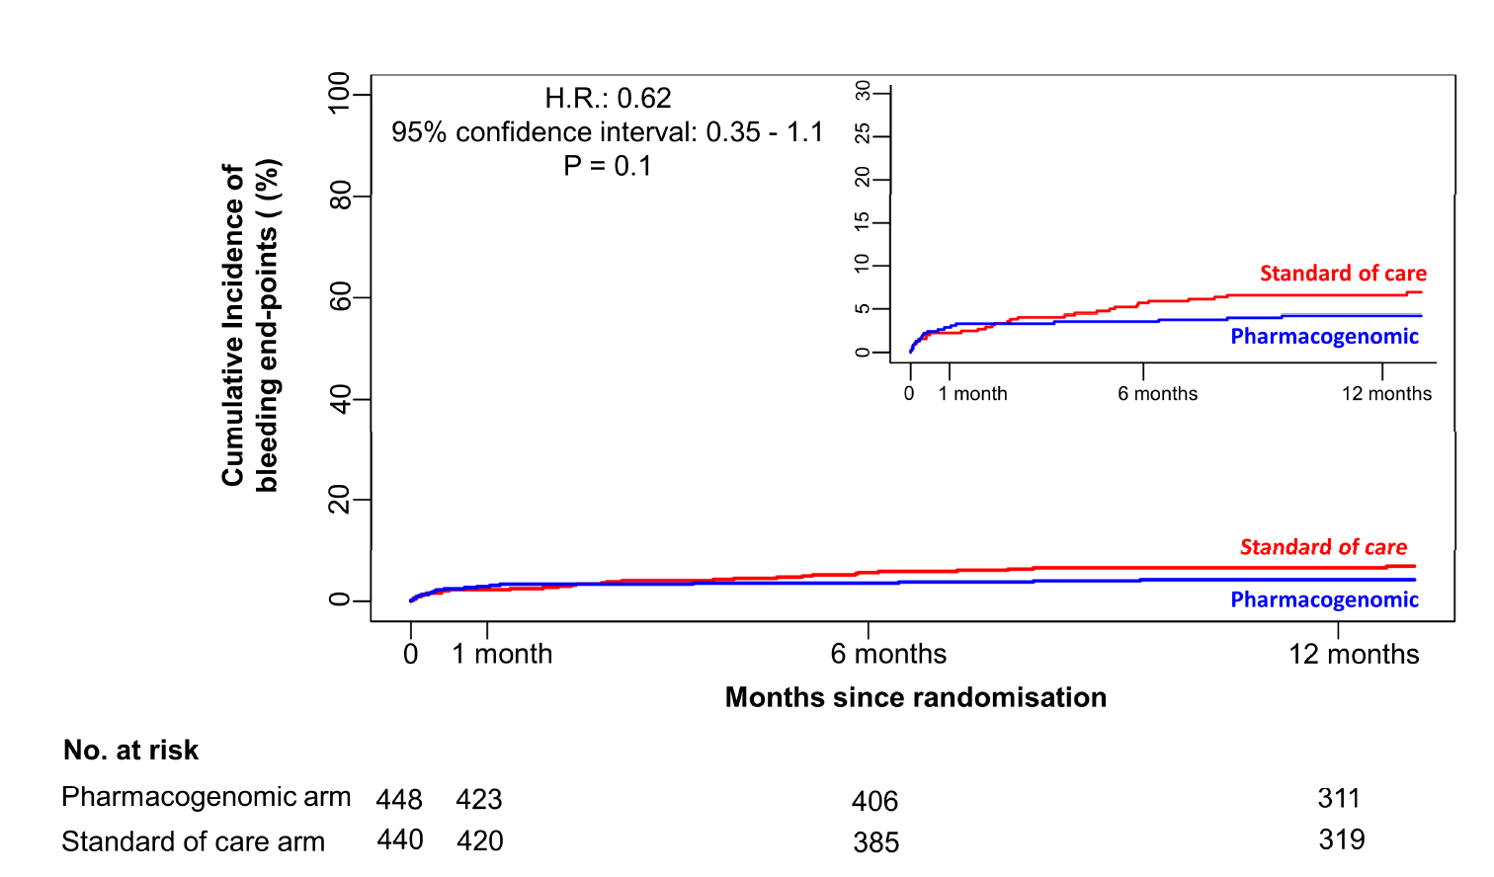
Guiding antiplatelet therapy in ACS using pharmacogenomics improves Bleeding Risks
Notarangelo, F., Maglietta, G., Bevilacqua, et al. (2018) Pharmacogenomic approach to selecting antiplatelet therapy in acute coronary syndromes: PHARMCLO trial. JACC (2.29.18), doi:10.1016/j.jacc2018.02.029.

Slide 99
Guiding antiplatelet therapy in ACS using pharmacogenomics improves outcomes
BaleDoneen Take-Away:
1. Antiplatelet therapy is an essential element for treatment following an acute coronary event.
2. Using genetics to drive medical management is now becoming mainstream for pharmacy selection.
3. Pharmacogenetics will help improve outcomes both for treatment effects and avoidance of dangerous side effects.
4. Pharmacogenetics ARE available NOW.
5. MyGenetx MyPGT includes: 4 ABCB1 SNPs and 10 SNPs of CYP2C19 including *2 and *17.
6. Precision based healthcare is the future – embrace it!
Notarangelo, F., Maglietta, G., Bevilacqua, et al. (2018) Pharmacogenomic approach to selecting antiplatelet therapy in acute coronary syndromes: PHARMCLO trial. JACC (2.29.18), doi:10.1016/j.jacc2018.02.029.

Slide 100



Slide 101


Mediterranean vs Vegetarian

Slide 102
Mediterranean Diet improves CVD risk factors better than low-calorie vegetarian diet.
Randomly assigned to overweight omnivores with a low-to-moderate cardiovascular risk profile a low-calorie Vegetarian diet (Vd) compared with a low-calorie Mediterranean diet (MD), each lasting 3 months, with a crossover design.
Primary outcome was the difference in body weight, body mass index, and fat mass.
Secondary outcomes were differences in circulating cardiovascular disease risk parameters.
Sofi, F., Dinu, M., Pagliani, G., et al. Low calorie vegetarian vs Mediterranean diets for reducing body weight and improving CVR profile (March 10, 2018). Circulation (2018);137:1103-1113

Slide 103
Mediterranean Diet improves CVD risk factors better than low-calorie vegetarian diet.
N=118, mean age: 51.1 years, females: 78% were enrolled. 84.7% compliance.
No differences between the 2 diets in body weight were observed, as reported by similar and significant reductions obtained by both Vd (‒1.88 kg) and MD (‒1.77 kg). Similar results were observed for BMI & fat mass.
Vd – improved LDL levels (p-0.01) while MD improved TG levels (p<0.01).
No significant difference was found between Vd and MD interventions in oxidative stress markers and inflammatory cytokines, except for interleukin-17, which improved only in the MD group.
Sofi, F., Dinu, M., Pagliani, G., et al. Low calorie vegetarian vs Mediterranean diets for reducing body weight and improving CVR profile (March 10, 2018). Circulation (2018);137:1103-1113

Slide 104
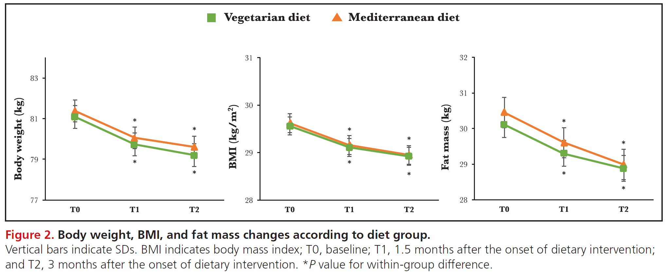
Mediterranean Diet improves CVD risk factors better than low-calorie vegetarian diet.
Sofi, F., Dinu, M., Pagliani, G., et al. Low calorie vegetarian vs Mediterranean diets for reducing body weight and improving CVR profile (March 10, 2018). Circulation (2018);137:1103-1113

Slide 105
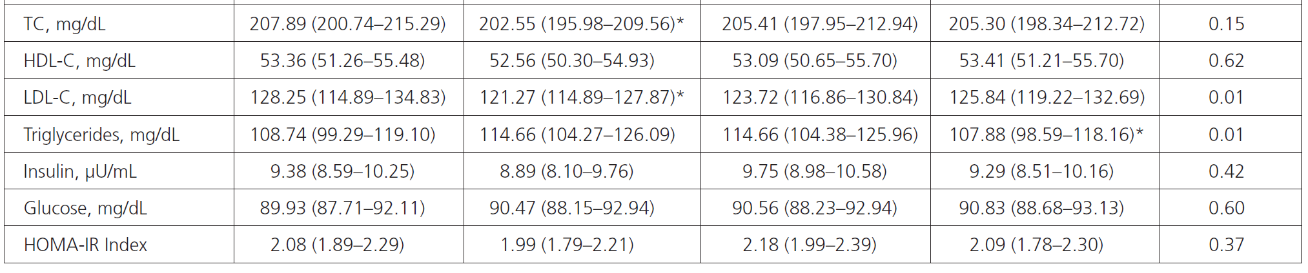
Mediterranean Diet improves CVD risk factors better than low-calorie vegetarian diet.
Sofi, F., Dinu, M., Pagliani, G., et al. Low calorie vegetarian vs Mediterranean diets for reducing body weight and improving CVR profile (March 10, 2018). Circulation (2018);137:1103-1113

Slide 106
Mediterranean Diet improves CVD risk factors better than low-calorie vegetarian diet.
BaleDoneen Take Away:
1. No Apo E or Hp testing was done to individualize treatment
2. Both groups showed improvement in body weight, body fat and overall BMI with no statistical difference between 2 groups
3. MD showed improved dyslipidemia control (TG) and decreased inflammation (IL-17).
4. Vd showed improvement of LDL.
5. Our recommendations remain the same – guide diet with precision decisions using Apo E and Hp along with other indices such as MetSynd and IR and lipid issues.
Sofi, F., Dinu, M., Pagliani, G., et al. Low calorie vegetarian vs Mediterranean diets for reducing body weight and improving CVR profile (March 10, 2018). Circulation (2018);137:1103-1113

Slide 107

Omega 3 – worthless?

Slide 108
Omega-3 and CVD – meta analysis
Current guidelines advocate the use of marine-derived omega-3 fatty acids supplements for the prevention of coronary heart disease and major vascular events in people with prior coronary heart disease.
Aim: To conduct a meta-analysis of all large trials assessing the associations of omega-3 fatty acid supplements with the risk of fatal and nonfatal coronary heart disease and major vascular events in the full study population and prespecified subgroups.
Aung, T., Halsey, J., Gerstein, H., et al. (2018). Association of omega-3 fatty acid supplement use with CVD risks. Meta analysis of 10 trials. JAMA Cardiology. 2018. doi 10.001/jamacardio.

Slide 109
Omega-3 and CVD – meta analysis
This meta-analysis included randomized trials that involved at least 500 participants and a treatment duration of at least 1 year and that assessed associations of omega-3 fatty acids with the risk of vascular events.
Aggregated study-level data were obtained from 10 large randomized clinical trials.
Aung, T., Halsey, J., Gerstein, H., et al. (2018). Association of omega-3 fatty acid supplement use with CVD risks. Meta analysis of 10 trials. JAMA Cardiology. 2018. doi 10.001/jamacardio.

Slide 110
Omega-3 and CVD – meta analysis
The main outcomes included fatal CHD, nonfatal MI, stroke, major vascular events, and all-cause mortality, as well as major vascular events
Of the 77 917 high-risk individuals participating in the 10 trials, 47 803 (61.4%) were men, and the mean age at entry was 64.0 years; the trials lasted a mean of 4.4 years.
Randomization to omega-3 fatty acid supplementation (EPA range, 226-1800mg/d) had no significant associations with coronary heart disease death (rate ratio [RR], 0.93; 99%CI, 0.83-1.03; P = .05).
Aung, T., Halsey, J., Gerstein, H., et al. (2018). Association of omega-3 fatty acid supplement use with CVD risks. Meta analysis of 10 trials. JAMA Cardiology. 2018. doi 10.001/jamacardio.
Notes:
The associations of treatment with outcomes were assessed on 6273 coronary heart disease events (2695 coronary heart disease deaths and 2276 nonfatalmyocardial infarctions) and 12 001 major vascular events.

Slide 111
Omega-3 and CVD – meta analysis
Study Conclusion:
This meta-analysis demonstrated that omega-3 fatty acids had no significant association with fatal or nonfatal coronary heart disease or any major vascular events.
It provides no support for current recommendations for the use of such supplements in people with a history of coronary heart disease
Aung, T., Halsey, J., Gerstein, H., et al. (2018). Association of omega-3 fatty acid supplement use with CVD risks. Meta analysis of 10 trials. JAMA Cardiology. 2018. doi 10.001/jamacardio.

Slide 112
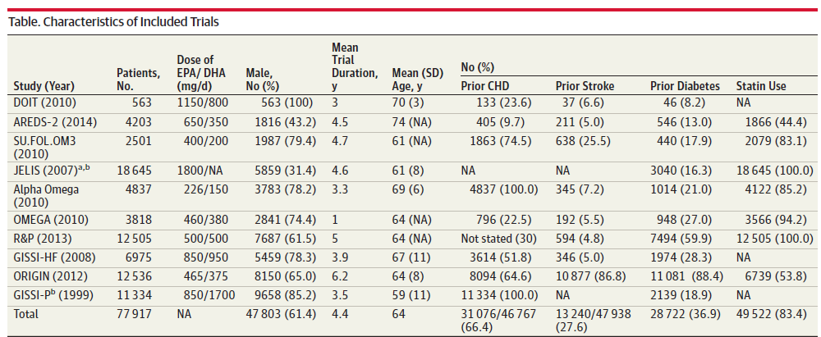
Omega-3 and CVD – meta analysis
N=27,895 had sub-therapeutic doses of EPA and/or DHA (36%)
Aung, T., Halsey, J., Gerstein, H., et al. (2018). Association of omega-3 fatty acid supplement use with CVD risks. Meta analysis of 10 trials. JAMA Cardiology. 2018. doi 10.001/jamacardio.

Slide 113
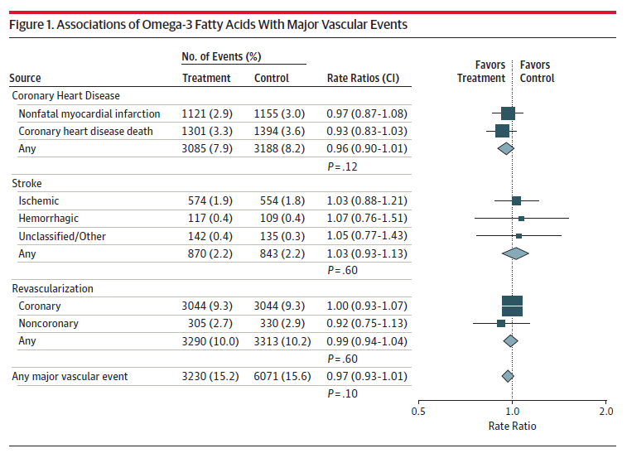
Omega-3 and CVD – meta analysis
Aung, T., Halsey, J., Gerstein, H., et al. (2018). Association of omega-3 fatty acid supplement use with CVD risks. Meta analysis of 10 trials. JAMA Cardiology. 2018. doi 10.001/jamacardio.

Slide 114
Omega-3 and CVD – meta analysis
Authors state this meta-analysis had several limitations.
The protocol did not prespecify assessment of the effects of treatment by smoking status or by site-specific cancer incidence. An additional limitation of this meta analysis involved the use of aggregated study level data rather than individual-level data.
A meta-analysis of individual participant data may have a greater chance of detecting effects of omega-3 FA supplements on subtypes of fatal CHD events (ie, sudden death or ventricular arrhythmias) in a wider range of subgroups.
Aung, T., Halsey, J., Gerstein, H., et al. (2018). Association of omega-3 fatty acid supplement use with CVD risks. Meta analysis of 10 trials. JAMA Cardiology. 2018. doi 10.001/jamacardio.

Slide 115
Omega-3 and CVD – meta analysis
BaleDoneen Take-Away:
1. Precision based healthcare depends on making INDIVIDUAL, genetically based recommendations.
2. This meta-analysis demonstrates how complex a decision like adding Omega-3 actually is – the pills are expensive and hard to swallow.
3. Always ask: Can the patient benefit from eating foods rich in Omega 3 such as salmon for Pleiotropic benefit.
4. Meta-analysis cannot evaluate Apo E population or inflammation (OCEAN trial) or appropriate doses (JELIS trial).
5. Dosing ranges were as low as 226 mg EPA – this meta analysis proves that dose matters as does predisposition, statin drop in and genetics. Be specific in recommendations.
6. Remember vulnerable groups such as T2DM, IR, dyslipidemia and inflammation and Apo E 2 folks – added benefit?
Aung, T., Halsey, J., Gerstein, H., et al. (2018). Association of omega-3 fatty acid supplement use with CVD risks. Meta analysis of 10 trials. JAMA Cardiology. 2018. doi 10.001/jamacardio.

Slide 116
Upcoming events next month for BaleDoneen
April 3 – Amy Medical Toolkit talk (online)
April 5 – Amy in San Diego- oral/systemic
April 11 – Brad next Scientific Update (online)
April 13 – Brad in Victoria TX – oral/systemic
April 15 – Amy in Tacoma WA – Women’s Heart Health Event

Slide 117



Thank you for joining me for the March 2018 BD Scientific Update.

